Slide 1
Flexão (Vigas)
Disponivel em: www.tallesmello.com.br

Slide 2
Dimensionamento
Momento Fletor: Flambagem Lateral com Torção (FLT)
Momento Fletor: Flambagem Local da Mesa (FLM)
Momento Fletor: Flambagem Local da Alma (FLA)
No projeto de vigas sujeitas a flexão simples, no estado limite último, calculam-se o momento resistente de projeto nas seções críticas e comparam-se com os esforços solicitantes.

Slide 3
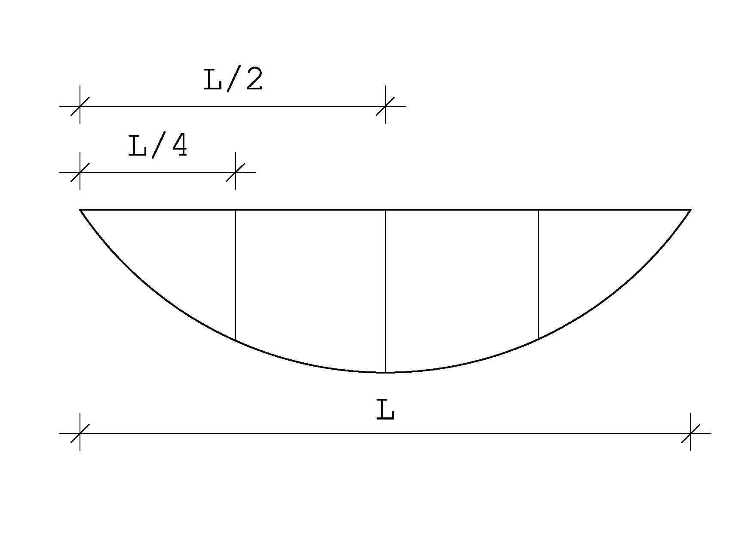
Momento Fletor: Flambagem Lateral com Torção (FLT)
$λ_{FLT}=\frac{L}{r_{y}}$ $λ_{p}=1,76\sqrt{\frac{E}{F_{y}}}$ $λ_{r}=\frac{1,38\sqrt{I_{y}J}}{r_{y} J β_{1}}\sqrt{1+\sqrt{1+\frac{27C_{w}β_{1}^{2}}{I_{y}}}}$
${ β}_{1}= \frac{\left(f_{y}−σ_{r}\right) W_{x}}{EJ}$ $λ_{FLT}≤λ_{p}→M_{Rd}=\frac{M_{PL}}{γ_{a1}}$
$λ_{p}<λ_{FLT}≤λ_{r}→M_{Rd}=\frac{C_{b}}{γ_{a1}}\left[M_{PL}−\left(M_{PL}−M_{r}\right) .\frac{λ_{FLT}−λ_{p}}{λ_{r}−λ_{p}}\right]≤ \frac{M_{PL}}{γ_{a1}}$
$C_{b}= \frac{12,5.M_{max}}{2,5.M_{max}+4.M_{B}+3.M_{C}}≤3,0$
$M_{PL}=Z . F_{y}$ $M_{r}=\left(f_{y}−σ_{r}\right) W_{x}$
$λ_{FLT}>λ_{r}→M_{Rd}=\frac{M_{cr}}{γ_{a1}} ≤\frac{M_{PL}}{γ_{a1}}$
$M_{cr}= \frac{C_{b}.π^{2}.E.I_{y}}{L_{b}^{2}}\sqrt{\frac{C_{w}}{I_{y}}\left(1+0,039\frac{J{.L}_{b}^{2}}{C_{w}}\right)}$

Slide 4
Momento Fletor: Flambagem Local da Mesa (FLM)
$λ_{FLM}=\frac{b}{2t}$ $λ_{p}=0,38\sqrt{\frac{E}{F_{y}}}$ $λ_{r}=0,83\sqrt{\frac{E}{F_{y}−σ_{r}}}$
$λ_{FLM}≤λ_{p}→M_{Rd}=\frac{M_{PL}}{γ_{a1}}$
$λ_{p}<λ_{FLM}≤λ_{r}→M_{Rd}=\frac{C_{b}}{γ_{a1}}\left[M_{PL}−\left(M_{PL}−M_{r}\right) .\frac{λ_{FLM}−λ_{p}}{λ_{r}−λ_{p}}\right]≤ \frac{M_{PL}}{γ_{a1}}$
$λ_{FLM}>λ_{r}→M_{Rd}=\frac{M_{cr}}{γ_{a1}} ≤\frac{M_{PL}}{γ_{a1}} → M_{cr}=\frac{0,69 E W_{c}}{λ^{2}}$

Slide 5
Momento Fletor: Flambagem Local da Alma (FLA)
$λ_{FLA}=\frac{d^{′}}{t_{w}}$ $λ_{p}=3,74 \sqrt{\frac{E}{f_{y}}}$ $λ_{r}=5,70. \sqrt{\frac{E}{f_{y}}}$
$λ_{FLA}≤λ_{p}→M_{Rd}=\frac{M_{PL}}{γ_{a1}}$ $M_{PL}=Z . F_{y}$
$λ_{p}<λ_{FLA}≤λ_{r}→M_{Rd}=\frac{C_{b}}{γ_{a1}}\left[M_{PL}−\left(M_{PL}−M_{r}\right). \frac{λ_{FLA}−λ_{p}}{λ_{r}−λ_{p}}\right] ≤ \frac{M_{PL}}{γ_{a1}}$

Slide 6
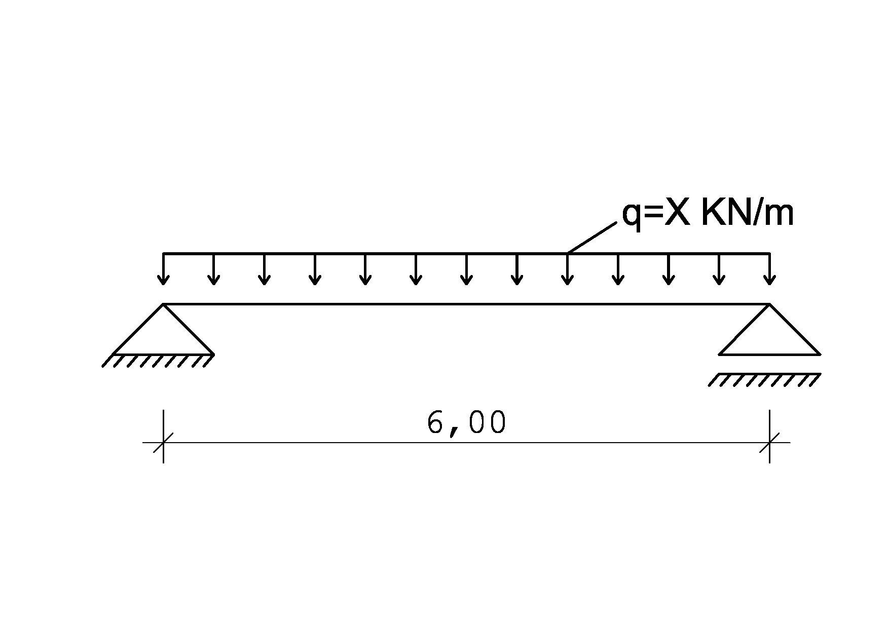
Exercício 1
Conforme viga biapoiada abaixo, verifique se a peça irá resistir ao momento solicitante.
Calcule $λ_{FLT}; λ_{FLM} ; λ_{FLA}$
Dados: Perfil W – 150x18,0
E = 200 Gpa=20000 KN/cm²
X = 3
Cw = 6683 ${cm}^{6}$; Fy = 25 KN/cm²
It = J = 4,34 ${cm}^{4}$
BITOLA | Massa Linear | d | b_{f} | Espessura |  | h | d' | Área
 |  |  |  | tw | tf
mm x kg/m | kg/m | mm | mm | mm | mm | mm | mm | cm²
W 150 x 18,0 | 18 | 153 | 102 | 5,8 | 7,1 | 139 | 119 | 23,4
Eixo X-X |  |  |  | Eixo Y-Y
I_{x} | W_{x} | r_{x} | Z_{x} | I_{y} | W_{y} | r_{y} | Z_{y}
cm⁴ | cm³ | cm | cm³ | cm⁴ | cm³ | cm | cm³
939 | 122,8 | 6,34 | 139,4 | 126 | 24,7 | 2,32 | 38,5

Slide 7
FLT
$λ_{FLT}=\frac{L}{r_{y}}=\frac{600}{2,32}=258,62$ $λ_{p}=1,76\sqrt{\frac{E}{F_{y}}}=1,76\sqrt{\frac{20000}{25}}=49,78$
${ β}_{1}= \frac{\left(f_{y}−σ_{r}\right) W_{x}}{EJ}=\frac{\left(25−25 . 0,3\right).122,8}{20000 . 4,34}=0,025 {cm}^{−1}$
$λ_{r}=\frac{1,38\sqrt{I_{y}J}}{r_{y} J β_{1}}\sqrt{1+\sqrt{1+\frac{27C_{w}β_{1}^{2}}{I_{y}}}}=\frac{1,38 . \sqrt{126 . 4,34}}{2,32 . 4,34 . 0,025} .\sqrt{1+\sqrt{1+\frac{27 . 6683 . 0,025²}{126}}}=197,64$
$$C_{b}= \frac{12,5.M_{max}}{2,5.M_{max}+4.M_{B}+3.M_{C}}=\frac{12,5 . 1350}{2,5 . 1350+4 . 1350+3 . 1012,5}=1,43≤3,0$$

Slide 8
FLT
$$M_{A}=M_{C}=\frac{3 . q . L²}{32}=\frac{3 . 3 . 6²}{32}=10,125 KNm= 1012,5 KNcm$$
$$M_{B}$$
$$M_{C}$$
$$M_{B}=\frac{q L²}{8}=\frac{3 . 6²}{8}=13,5 KNm=1350 KNcm$$
$λ_{FLT}>λ_{r}→M_{Rd}=\frac{M_{cr}}{γ_{a1}} ≤\frac{M_{PL}}{γ_{a1}}$
$M_{cr}= \frac{C_{b}.π^{2}.E.I_{y}}{L_{b}^{2}}\sqrt{\frac{C_{w}}{I_{y}}\left(1+0,039\frac{J{.L}_{b}^{2}}{C_{w}}\right)}=\frac{1,43 .π^{2} . 20000 . 126}{600²}$ . $\sqrt{\frac{6683}{126}\left(1+0,039\frac{4,34 . 600²}{6683}\right)}=2288,63 KNcm$
$M_{PL}=Z . F_{y}=139,4 . 25=3485 KNcm$
$M_{Rd}=\frac{M_{cr}}{γ_{a1}} ≤\frac{M_{PL}}{γ_{a1}}→\frac{2288,63}{1,1}≤\frac{3485}{1,1}=2080,57≤3168,18$
$M_{Rd}=2080,57 KNcm$

Slide 9
$λ_{FLM}=\frac{b}{2t}=\frac{10,2}{2 . 0,71}=7,18$ $λ_{p}=0,38\sqrt{\frac{E}{F_{y}}}=0,38 \sqrt{\frac{20000}{25}}=10,75$
$λ_{r}=0,83\sqrt{\frac{E}{F_{y}−σ_{r}}}=0,83 \sqrt{\frac{20000}{25 −25 . 0,3}}=28,06$
$$λ_{FLM}≤λ_{p}→M_{Rd}=\frac{M_{PL}}{γ_{a1}}=\frac{3485}{1,1}=3168,18kNcm; M_{PL}=Z . F_{y}=139,4 . 25=3485 KNcm$$
FLM
FLA
$λ_{FLA}=\frac{d^{′}}{t_{w}}=\frac{11,9}{0,58}=20,52$ $λ_{p}=3,74 \sqrt{\frac{E}{f_{y}}}=3,74\sqrt{\frac{20000}{25}}=105,78 λ_{r}=5,70. \sqrt{\frac{E}{f_{y}}}=5,70\sqrt{\frac{20000}{25}}=161,22$
$$λ_{FLA}≤λ_{p}→M_{Rd}=\frac{M_{PL}}{γ_{a1}}=\frac{3485}{1,1}=3168,18 kNcm; M_{PL}=Z . F_{y}=139,4 . 25=3485 KNcm$$
$M_{Rd}=2080,57 kNcm>1350 kNcm→OK!$

Slide 10
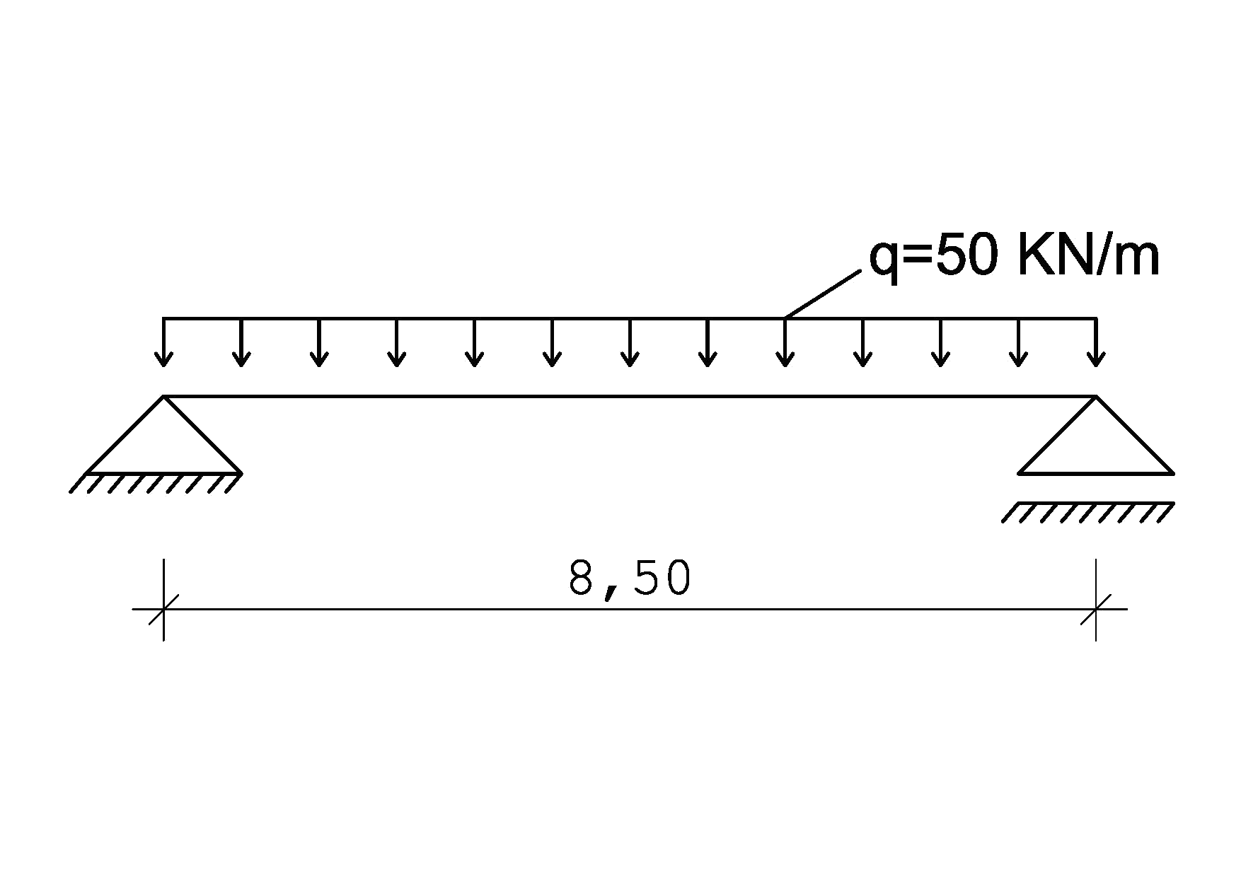
Exercício 02
Conforme viga biapoiada abaixo, verifique se a peça irá resistir ao momento solicitante.
Calcule $λ_{FLT}; λ_{FLM} ; λ_{FLA}$
Dados: Perfil W – 610x174,0
E = 200 Gpa=20000 KN/cm²
Cw = 10915665 ${cm}^{6}$;
Fy = 25 KN/cm²
It = J = 286,88 ${cm}^{4}$
$$M_{B}$$
$$M_{C}$$
$$M_{A}=M_{C}=\frac{3 . q . L²}{32}=\frac{3 . 50 . 8,5²}{32}=338,672 KNm=33.867,19 KNcm$$
$$M_{B}=\frac{q L²}{8}=\frac{50 . 8,5²}{8}=451,56 KNm=45156,25 KNcm$$

Slide 11
 |  |  | Espessura |  |  |  |  | Eixo X-X |  |  |  | Eixo Y-Y
BITOLA | d | b_{f} | tw | tf | h | d' | Ag | I_{x} | W_{x} | r_{x} | Z_{x} | I_{y} | W_{y} | r_{y} | Z_{y}
mm x kg/m | mm | mm | mm | mm | mm | mm | cm² | cm⁴ | cm³ | cm | cm³ | cm⁴ | cm³ | cm | cm³
W 610 x 174,0 | 616 | 325 | 14 | 22 | 573 | 541 | 223 | 147754 | 4797,2 | 26 | 5383 | 12374 | 761,5 | 7 | 1171
$λ_{FLT}=\frac{L}{r_{y}}=\frac{850}{7,45}=114,09$ $λ_{p}=1,76\sqrt{\frac{E}{F_{y}}}=1,76\sqrt{\frac{20000}{25}}=49,78$
${ β}_{1}= \frac{\left(f_{y}−σ_{r}\right) W_{x}}{EJ}=\frac{\left(25−25 . 0,3\right). 4797,2}{20000 . 286,88}=0,0146 {cm}^{−1}$
$λ_{r}=\frac{1,38\sqrt{I_{y}J}}{r_{y} J β_{1}}\sqrt{1+\sqrt{1+\frac{27C_{w}β_{1}^{2}}{I_{y}}}}=\frac{1,38 . \sqrt{12374 . 286,88}}{7,45 . 286,88 . 0,0146} .\sqrt{1+\sqrt{1+\frac{27 . 10915665 . 0,0146²}{12374}}}=154,87$
$$C_{b}= \frac{12,5.M_{max}}{2,5.M_{max}+4.M_{B}+3.M_{C}}=\frac{12,5 . 45156,25}{2,5 .45156,25+4 .45156,25+3 .33867,19}=1,43≤3,0$$
FLT

Slide 12
$λ_{p}<λ_{FLT}≤λ_{r}→M_{Rd}=\frac{C_{b}}{γ_{a1}}\left[M_{PL}−\left(M_{PL}−M_{r}\right) .\frac{λ_{FLT}−λ_{p}}{λ_{r}−λ_{p}}\right]≤ \frac{M_{PL}}{γ_{a1}}$
$M_{PL}=Z . F_{y}=5383 . 25=134575 KNcm;$
$M_{r}=\left(f_{y}−σ_{r}\right) W_{x}=\left(25−0,3 . 25\right).4797,2=83951 kNcm$
$M_{Rd}=\frac{C_{b}}{γ_{a1}}\left[M_{PL}−\left(M_{PL}−M_{r}\right) .\frac{λ_{FLT}−λ_{p}}{λ_{r}−λ_{p}}\right]≤ \frac{M_{PL}}{γ_{a1}}$
$→\frac{1,43}{1,1}\left[134575−\left(134575−83951\right) .\frac{114,09−49,78}{154,87−49,78}\right]$
$M_{Rd}=134542,02 KNcm;M_{Rd}≤ \frac{M_{PL}}{γ_{a1}}=\frac{134575}{1,1}=122340,91;$
$M_{Rd}=122340,91kNcm$
FLT

Slide 13
FLM
$λ_{FLM}=\frac{b}{2t}=\frac{32,5}{2 . 2,16}=7,$52
$λ_{p}=0,38\sqrt{\frac{E}{F_{y}}}=0,38 \sqrt{\frac{20000}{25}}=10,75$
$λ_{r}=0,83\sqrt{\frac{E}{F_{y}−σ_{r}}}=0,83 \sqrt{\frac{20000}{25 −25 . 0,3}}=28,06$
$$λ_{FLM}≤λ_{p}→M_{Rd}=\frac{M_{PL}}{γ_{a1}}=\frac{134575}{1,1}=122340,91kNcm;$$

Slide 14
FLA
$λ_{FLA}=\frac{d^{′}}{t_{w}}=\frac{54,1}{1,4}=38,64$
$$λ_{p}=3,74 \sqrt{\frac{E}{f_{y}}}=3,74\sqrt{\frac{20000}{25}}=105,78$$
$$λ_{r}=5,70. \sqrt{\frac{E}{f_{y}}}=5,70\sqrt{\frac{20000}{25}}=161,22$$
$$λ_{FLA}≤λ_{p}→M_{Rd}=\frac{M_{PL}}{γ_{a1}}=\frac{3485}{1,1}=122340,91kNcm;$$
$M_{Rd}=122340,91kNcm>45156,25kNcm→OK!$

Slide 15
Exercício 03
Conforme viga biapoiada abaixo, verifique se a peça irá resistir ao momento solicitante.
Calcule $λ_{FLT}; λ_{FLM} ; λ_{FLA}$
Dados: E = 200 Gpa=20000 KN/cm²; Fy = 25 KN/cm²
 |  | Espessura |  |  |  |  | Eixo X-X |  |  |  | Eixo Y-Y
BITOLA | b_{f} | tw | tf | h | d' | Área | I_{x} | W_{x} | r_{x} | Z_{x} | I_{y} | W_{y} | r_{y} | Z_{y} | I_{t} | C_{w}
mm x kg/m | mm | mm | mm | mm | mm | cm² | cm⁴ | cm³ | cm | cm³ | cm⁴ | cm³ | cm | cm³ | cm⁴ | cm⁶
W 410 x 75,0 | 180 | 9,7 | 16 | 381 | 357 | 95,8 | 27616 | 1337,3 | 16,98 | 1518,6 | 1559 | 173,2 | 4,03 | 269,1 | 65,21 | 612.784

Slide 16
 |  | Espessura |  |  |  |  | Eixo X-X |  |  |  | Eixo Y-Y
BITOLA | b_{f} | tw | tf | h | d' | Área | I_{x} | W_{x} | r_{x} | Z_{x} | I_{y} | W_{y} | r_{y} | Z_{y} | I_{t} | C_{w}
mm x kg/m | mm | mm | mm | mm | mm | cm² | cm⁴ | cm³ | cm | cm³ | cm⁴ | cm³ | cm | cm³ | cm⁴ | cm⁶
W 410 x 75,0 | 180 | 9,7 | 16 | 381 | 357 | 95,8 | 27616 | 1337,3 | 16,98 | 1518,6 | 1559 | 173,2 | 4,03 | 269,1 | 65,21 | 612784
$λ_{FLT}=\frac{L}{r_{y}}=\frac{850}{4,03}=210,92$ $λ_{p}=1,76\sqrt{\frac{E}{F_{y}}}=1,76\sqrt{\frac{20000}{25}}=49,78$
$λ_{r}=\frac{1,38\sqrt{I_{y}J}}{r_{y} J β_{1}}\sqrt{1+\sqrt{1+\frac{27C_{w}β_{1}^{2}}{I_{y}}}}=\frac{1,38 . \sqrt{1559 . 65,21}}{4,03 . 65,21 . 0,0179} .\sqrt{1+\sqrt{1+\frac{27 . 612784 . 0,0179²}{1559}}}=164,63$
${ β}_{1}= \frac{\left(f_{y}−σ_{r}\right) W_{x}}{EJ}=\frac{\left(25−25 . 0,3\right). 1337,3}{20000 . 65,21}=0,0179 {cm}^{−1}$
FLT

Slide 17
FLT
$$M_{A}=M_{C}=\frac{3 . q . L²}{32}=\frac{3 . 50 . 8,5²}{32}=338,6719 KNm=33867,19 KNcm$$
$$M_{B}$$
$$M_{C}$$
$$M_{B}=\frac{q L²}{8}=\frac{50 . 8,5²}{8}=451,5625 KNm=45156,25 KNcm$$
$λ_{FLT}>λ_{r}→M_{Rd}=\frac{M_{cr}}{γ_{a1}} ≤\frac{M_{PL}}{γ_{a1}}$
$M_{cr}= \frac{C_{b}.π^{2}.E.I_{y}}{L_{b}^{2}}\sqrt{\frac{C_{w}}{I_{y}}\left(1+0,039\frac{J{.L}_{b}^{2}}{C_{w}}\right)}=\frac{1,43 .π^{2} . 20000 . 1559}{850²}$ . $\sqrt{\frac{612784}{1559}\left(1+0,039\frac{65,21 . 850²}{612784}\right)}=24146,56 KNcm$
$C_{b}= \frac{12,5.M_{max}}{2,5.M_{max}+4.M_{B}+3.M_{C}}=\frac{12,5 . 45156,25}{2,5 .45156,25+4 .45156,25+3 .33867,19}=1,43≤3,0$
$M_{PL}=Z . F_{y}=1518,6 . 25=37965 KNcm$
$M_{Rd}=\frac{M_{cr}}{γ_{a1}} ≤\frac{M_{PL}}{γ_{a1}}→\frac{24146,56}{1,1}≤\frac{37965}{1,1}=21951,42≤34514,64; M_{Rd}=21951,42 KNcm$

Slide 18
$λ_{FLM}=\frac{b}{2t}=\frac{18}{2 . 1,6}=5,63$; $λ_{p}=0,38\sqrt{\frac{E}{F_{y}}}=0,38 \sqrt{\frac{20000}{25}}=10,75$
$λ_{r}=0,83\sqrt{\frac{E}{F_{y}−σ_{r}}}=0,83 \sqrt{\frac{20000}{25 −25 . 0,3}}=28,06$
$$λ_{FLM}≤λ_{p}→M_{Rd}=\frac{M_{PL}}{γ_{a1}}=\frac{37965}{1,1}=34514,64kNcm;$$
FLM
$$λ_{FLA}=\frac{d^{′}}{t_{w}}=\frac{35,7}{0,97}=36,8; λ_{p}=3,74 \sqrt{\frac{E}{f_{y}}}=3,74\sqrt{\frac{20000}{25}}=105,78$$
$$λ_{r}=5,70. \sqrt{\frac{E}{f_{y}}}=5,70\sqrt{\frac{20000}{25}}=161,22; λ_{FLA}≤λ_{p}→M_{Rd}=\frac{M_{PL}}{γ_{a1}}==\frac{37965}{1,1}=34514,64kNcm;$$
FLA
$$M_{Rd}=21951,42 KNcm<45156,25 KNcm;A peça não irá suportar!$$

Slide 19
Exercício 04
Conforme viga biapoiada abaixo, verifique se a peça irá resistir ao momento solicitante. Calcule $λ_{FLT}; λ_{FLM} ; λ_{FLA}$
Perfil W 360 x 72,0
Dados: E = 200 Gpa=20000 KN/cm²; Fy = 25 KN/cm²; X equivale a 30.
$$5,0m$$
 | Espessura |  |  |  |  | Eixo X-X |  |  |  | Eixo Y-Y
b_{f} | tw | tf | h | d' | Área | I_{x} | W_{x} | r_{x} | Z_{x} | I_{y} | W_{y} | r_{y} | Z_{y} | I_{t} | C_{w}
mm | mm | mm | mm | mm | cm² | cm⁴ | cm³ | cm | cm³ | cm⁴ | cm³ | cm | cm³ | cm⁴ | cm⁶
204 | 8,6 | 15,1 | 320 | 288 | 91,3 | 20169 | 1152,5 | 14,86 | 1,285,9 | 2140 | 209,8 | 4,84 | 321,8 | 61,18 | 599.082

Slide 20
 | Espessura |  |  |  |  | Eixo X-X |  |  |  | Eixo Y-Y
b_{f} | tw | tf | h | d' | Área | I_{x} | W_{x} | r_{x} | Z_{x} | I_{y} | W_{y} | r_{y} | Z_{y} | I_{t} | C_{w}
mm | mm | mm | mm | mm | cm² | cm⁴ | cm³ | cm | cm³ | cm⁴ | cm³ | cm | cm³ | cm⁴ | cm⁶
204 | 8,6 | 15,1 | 320 | 288 | 91,3 | 20169 | 1152,5 | 14,86 | 1,285,9 | 2140 | 209,8 | 4,84 | 321,8 | 61,18 | 599.082
$λ_{FLT}=\frac{L}{r_{y}}=\frac{500}{4,84}=103,31$ $λ_{p}=1,76\sqrt{\frac{E}{F_{y}}}=1,76\sqrt{\frac{20000}{25}}=49,78$
$λ_{r}=\frac{1,38\sqrt{I_{y}J}}{r_{y} J β_{1}}\sqrt{1+\sqrt{1+\frac{27C_{w}β_{1}^{2}}{I_{y}}}}=\frac{1,38 . \sqrt{2140 . 61,18}}{4,84 . 61,18 . 0,0165} .\sqrt{1+\sqrt{1+\frac{27 . 599082 . 0,0165²}{2140}}}=169,44$
${ β}_{1}= \frac{\left(f_{y}−σ_{r}\right) W_{x}}{EJ}=\frac{\left(25−25 . 0,3\right). 1152,5}{20000 . 61,18}=0,0165 {cm}^{−1}$
FLT

Slide 21
FLT
$$M_{A}=M_{C}=\frac{3 . q . L²}{32}=\frac{3 . 30 . 5²}{32}=70,3125 KNm=7031,25 KNcm$$
$$M_{B}$$
$$M_{C}$$
$$M_{B}=\frac{q L²}{8}=\frac{30 . 5²}{8}=93,75 KNm=9375 KNcm$$
$λ_{p}<λ_{FLT}≤λ_{r}→M_{Rd}=\frac{C_{b}}{γ_{a1}}\left[M_{PL}−\left(M_{PL}−M_{r}\right) .\frac{λ_{FLT}−λ_{p}}{λ_{r}−λ_{p}}\right]≤ \frac{M_{PL}}{γ_{a1}}$
$M_{Rd}=\frac{C_{b}}{γ_{a1}}\left[M_{PL}−\left(M_{PL}−M_{r}\right) .\frac{λ_{FLT}−λ_{p}}{λ_{r}−λ_{p}}\right]=\frac{1,43}{1,1} \left[32147,5 −\left(32147,5−20168,75\right). \frac{103,31 −49,78 }{169,44−49,78}\right]=34825,44kNcm$
$C_{b}= \frac{12,5.M_{max}}{2,5.M_{max}+4.M_{B}+3.M_{C}}=\frac{12,5 . 9375}{2,5 .9375+4 .9375+3.7031,25}=1,43≤3,0$
$M_{PL}=Z . F_{y}=1285,9 . 25=32147,5 KNcm;M_{r}=\left(f_{y}−σ_{r}\right) W_{x}=\left(25−25 . 0,3\right). 1152,5=20168,75kNcm$
$M_{Rd}=34825,44kNcm≤\frac{32147,5}{1,1}=34825,44≤29225; M_{Rd}=29225 KNcm$

Slide 22
$λ_{FLM}=\frac{b_{f}}{2t}=\frac{20,4}{2 . 1,51}=6,75$; $λ_{p}=0,38\sqrt{\frac{E}{F_{y}}}=0,38 \sqrt{\frac{20000}{25}}=10,75$
$λ_{r}=0,83\sqrt{\frac{E}{F_{y}−σ_{r}}}=0,83 \sqrt{\frac{20000}{25 −25 . 0,3}}=28,06$
$$λ_{FLM}≤λ_{p}→M_{Rd}=\frac{M_{PL}}{γ_{a1}}=\frac{32147,5}{1,1}=29225 KNcm;$$
FLM
$$λ_{FLA}=\frac{d^{′}}{t_{w}}=\frac{28,8}{0,86}=33,49; λ_{p}=3,74 \sqrt{\frac{E}{f_{y}}}=3,74\sqrt{\frac{20000}{25}}=105,78$$
$$λ_{r}=5,70. \sqrt{\frac{E}{f_{y}}}=5,70\sqrt{\frac{20000}{25}}=161,22; λ_{FLA}≤λ_{p}→M_{Rd}=\frac{M_{PL}}{γ_{a1}}=\frac{32147,5}{1,1}=29225 KNcm;$$
FLA
$$M_{Rd}=29225 KNcm>9375 KNcm;$$
$$A peça irá suportar!$$
$$Entretanto, seria interessante redimensionar o perfil, buscando um novo perfil, a fim de se obter um resultado proximo a carga.$$

